Slide 1

503106
ADVANCED WEB PROGRAMMING
CHAPTER 5: Cookies & session
LESSON 05 – Cookies & session

Slide 2
Content
Cookie in Express
Sessions in Express
Using Sessions to Implement Flash Messages

Slide 3
Cookie in Express
HTTP is a stateless protocol
We need something to know who visiting our site.
Cookie is some information which server need to save at browser.
Cookie will be sent with requests

Slide 4
Cookie in Express
Cookies are not secret from the user
The user can delete or disallow cookies
Regular cookies can be tampered with ➔ use signed cookies
Cookies can be used for attacks
Users will notice if you abuse cookies
Prefer sessions over cookies

Slide 5
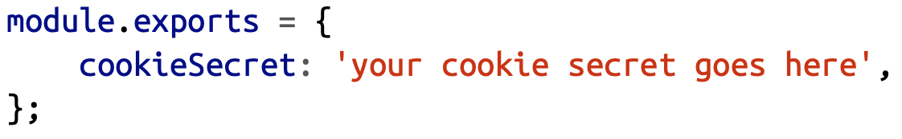
Signed cookies
To make cookies secure, a cookie secret is necessary. The cookie secret is a string that’s known to the server and used to encrypt secure cookies before they’re sent to the client.
Example: credentials.js
make sure we don’t accidentally add this file to our repository, add creden‐ tials.js to your .gitignore file.

Slide 6
Create cookies
To import your credentials into your application, all you need to do is:
First, npm install --save cookie-parser, then:
You can set a cookie or a signed cookie anywhere you have access to a response object:

Slide 7
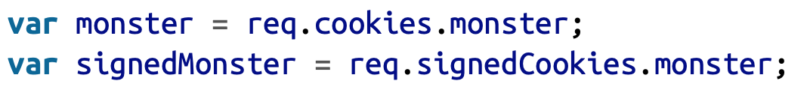
Read cookies
To retrieve the value of a cookie (if any) sent from the client, just access the cookie or signedCookie properties of the request object:
To delete a cookie, use res.clearCookie:

Slide 8
Cookie options
domain
path
maxAge
secure
httpOnly
signed

Slide 9
Sessions in Express
To implement sessions, something has to be stored on the client to know which session of which client.
Cookie
local storage
There are two ways to implement sessions:
Cookie-based sessions (cookie-session middleware)
Store only a unique identifier in the cookie and everything else on the server

Slide 10
Memory Stores
First, install express-session (npm install --save express-session); then, after linking in the cookie parser, link in express-session:
The express-session middleware accepts a configuration object with the following options:
key: The name of the cookie that will store the unique session identifier. Defaults to “connect.sid”.
store: An instance of a session store. Defaults to an instance of MemoryStore
cookie: Cookie settings for the session cookie (path, domain, secure, etc.).

Slide 11
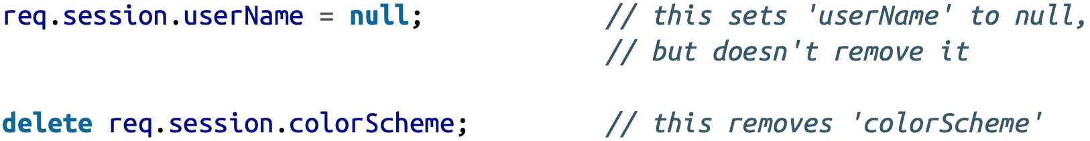
Using Sessions
Once you’ve set up sessions, using them couldn’t be simpler: just use properties of the request object’s session variable:
To delete a session, you can use JavaScript’s delete operator:

Slide 12
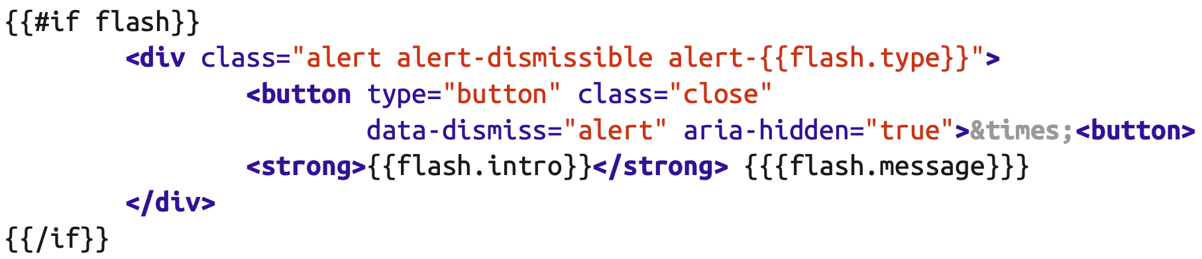
Using Sessions to Implement Flash Messages
“Flash” messages are simply a way to provide feedback to users in a way that’s not disruptive to their navigation.
The easiest way to implement flash messages is to use sessions

Slide 13
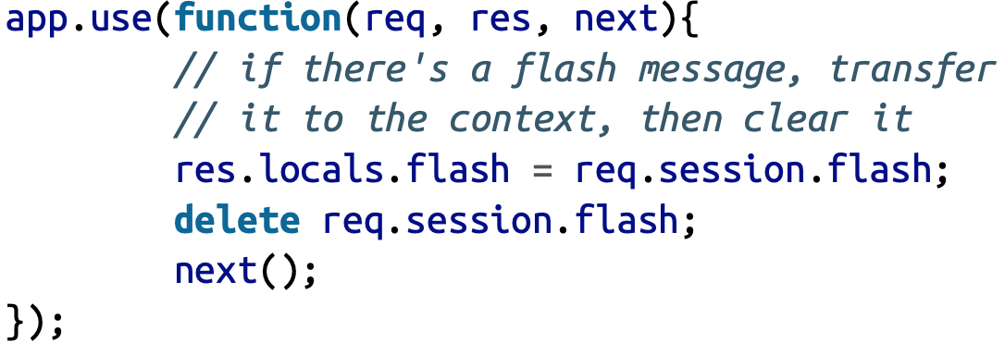
Using Sessions to Implement Flash Messages
Now let’s add some middleware to add the flash object to the context if there’s one in the session

Slide 14
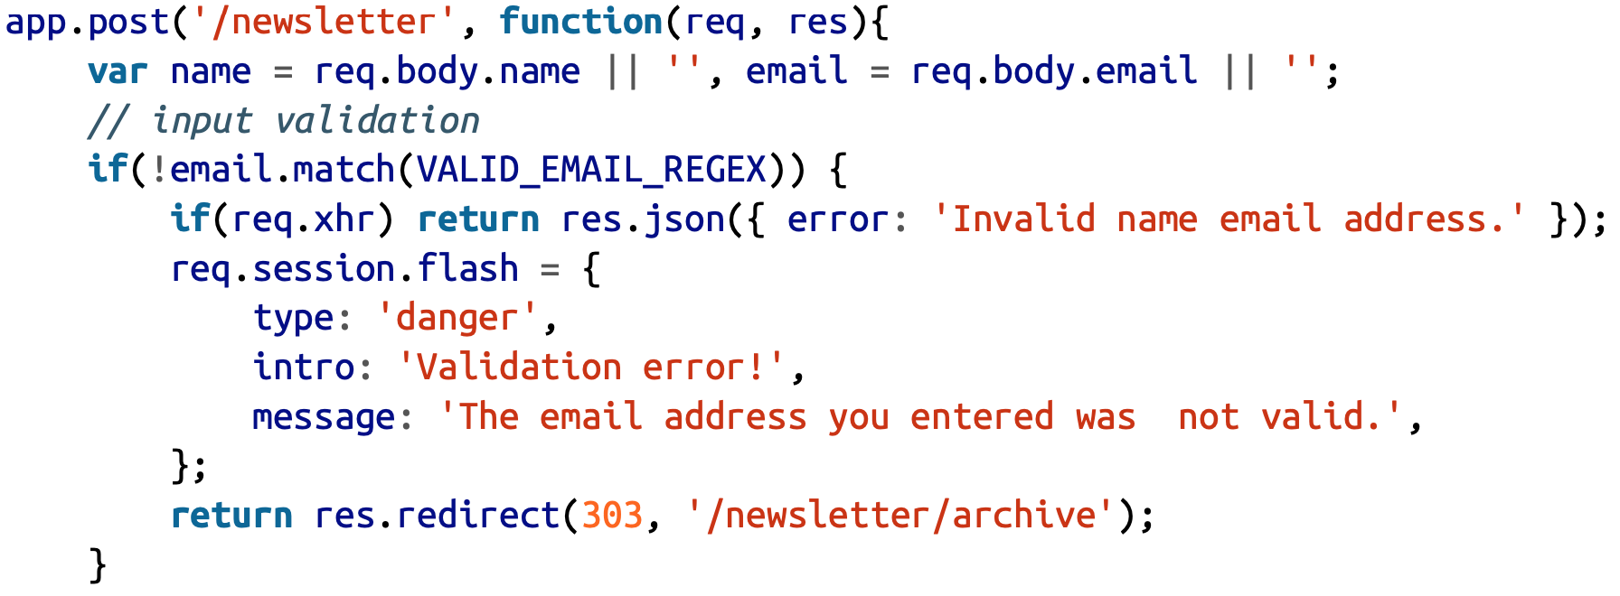
Example Flash Messages
Example: We’re signing up users for a newsletter, and we want to redirect them to the newsletter archive after they sign up.

Slide 15
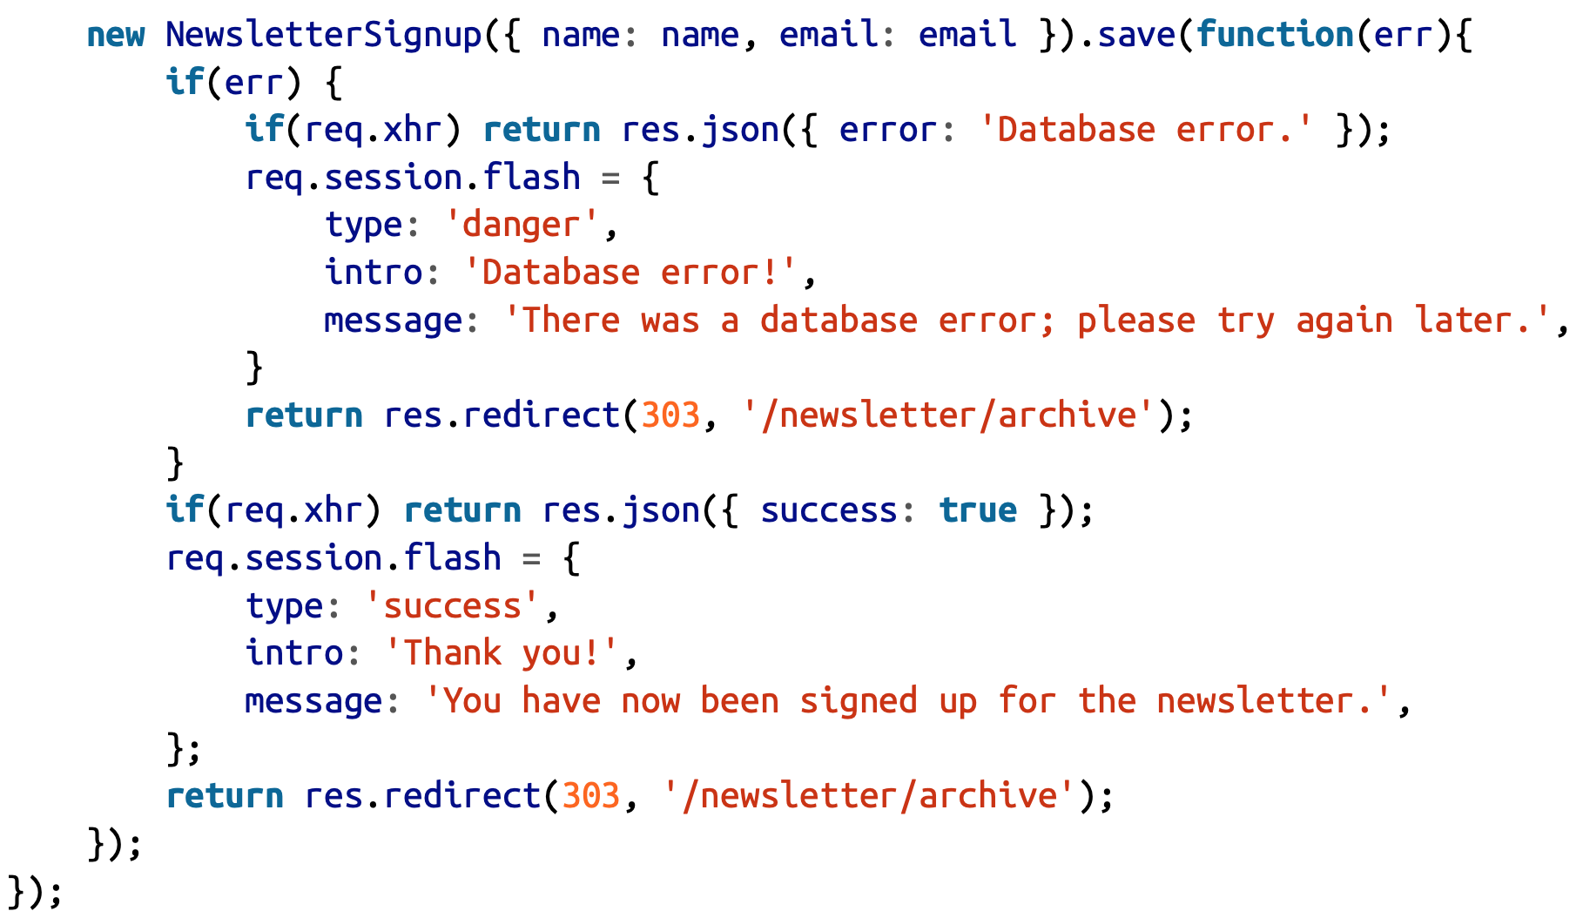

Slide 16
Exercises
Do login page: save user name in session then show in template

Slide 17

Execution Environments
We can set execution environment by calling app.set('env', 'production’)
Or set NODE_ENV when execute nodejs then use app.get(‘env’) to get its value.
Example:
or

Slide 18
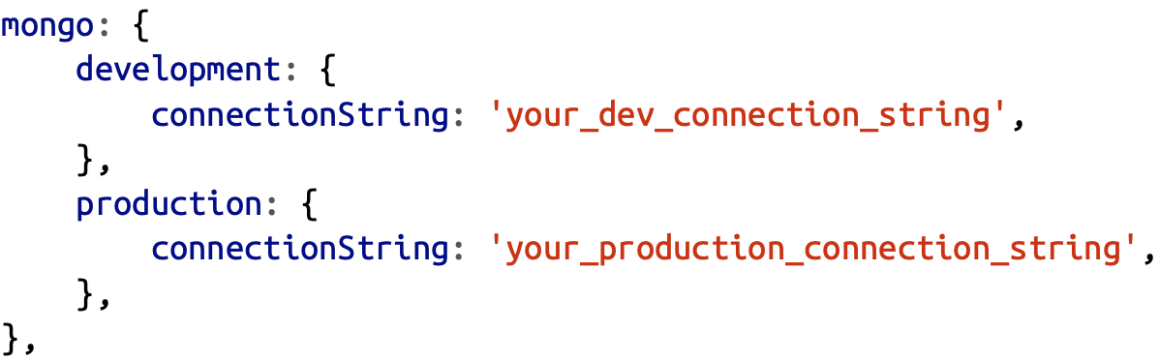
Database Persistence
We use MongoDB to save data
Before we get started, we’ll need to install the Mongoose module:
npm install --save mongoose
Then we’ll add our database credentials to the credentials.js file:

Slide 19
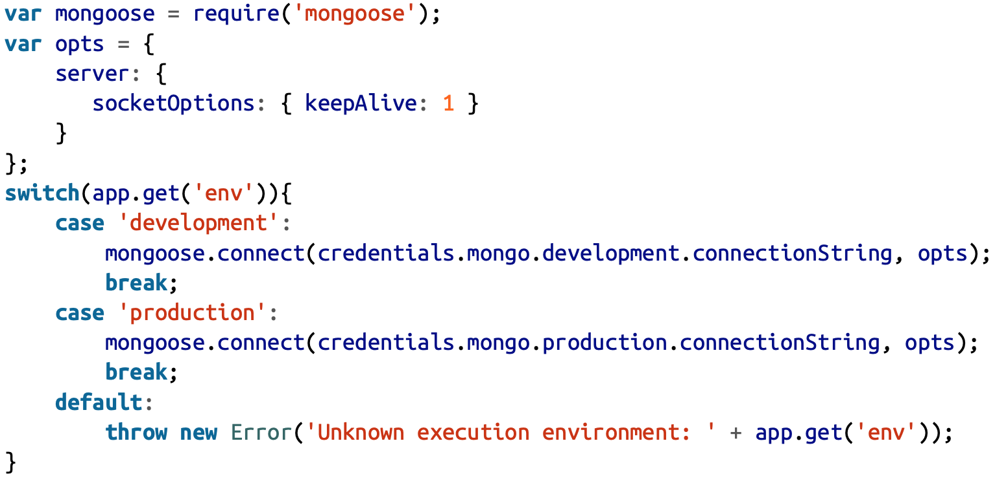
Database Connections with Mongoose

Slide 20
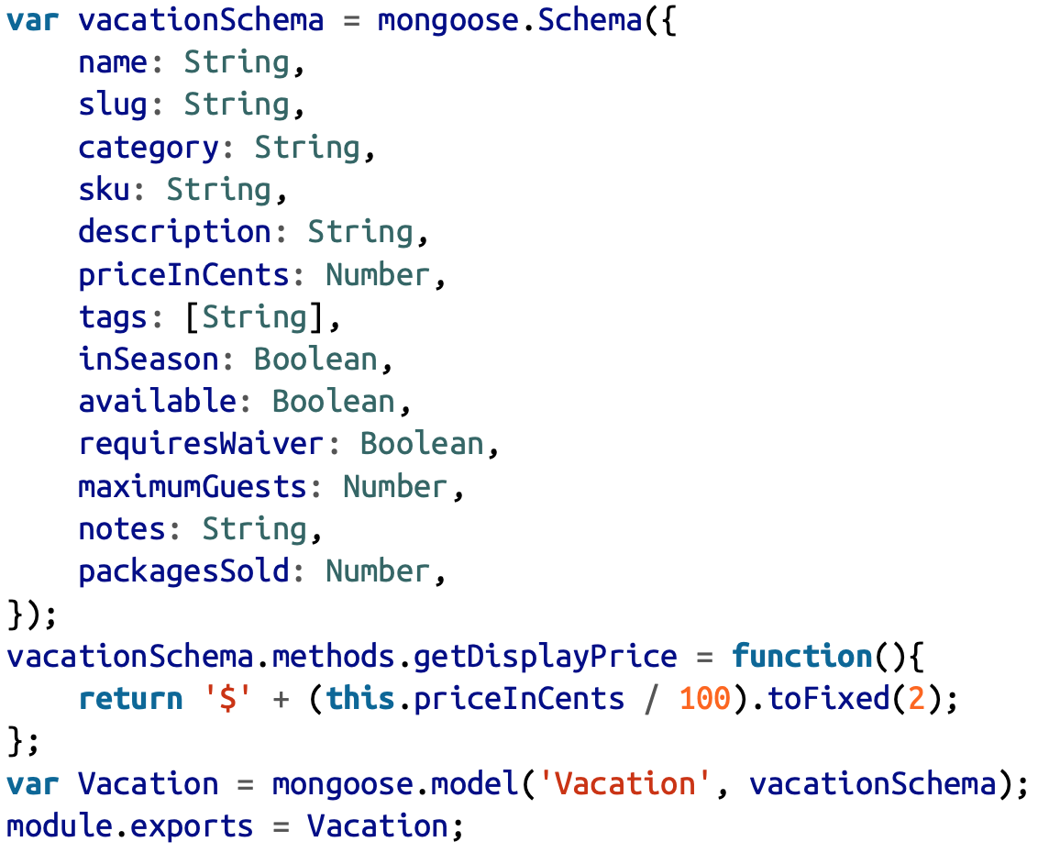
Creating Schemas and Models
To work with Mongo we need to define models
Example: models/vacation.js

Slide 21
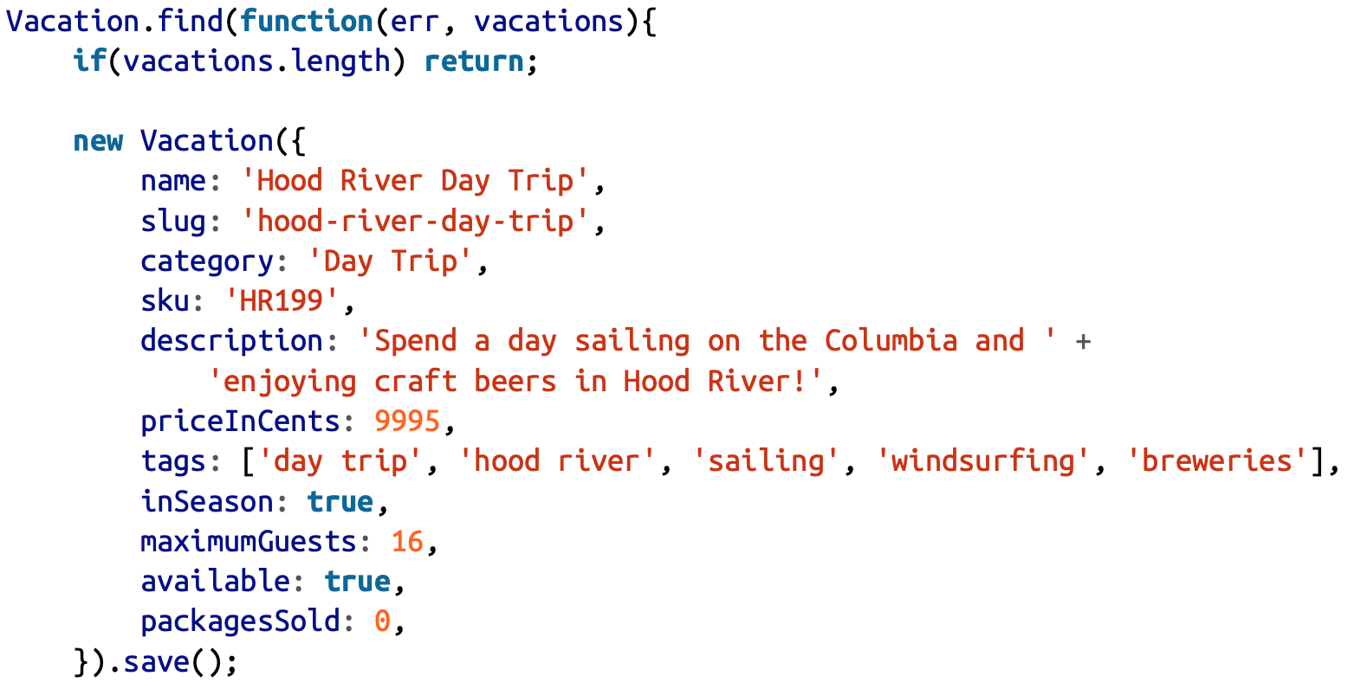
Seeding Initial Data
var Vacation = require('./models/vacation.js');

Slide 22
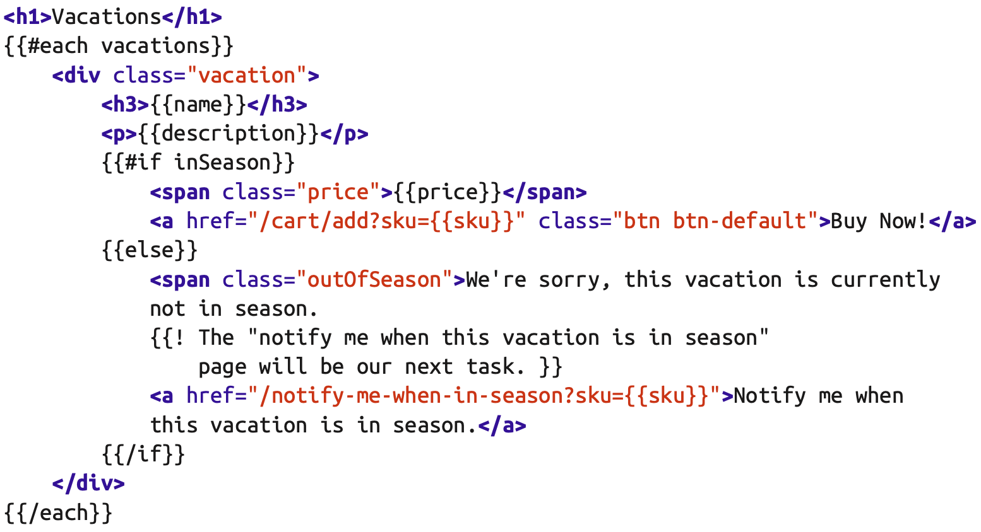
Retrieving Data
To display only vacations that are currently available create a view for the vacations page, views/vacations.handlebars:

Slide 23
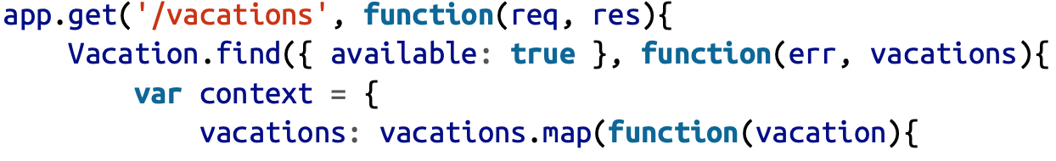
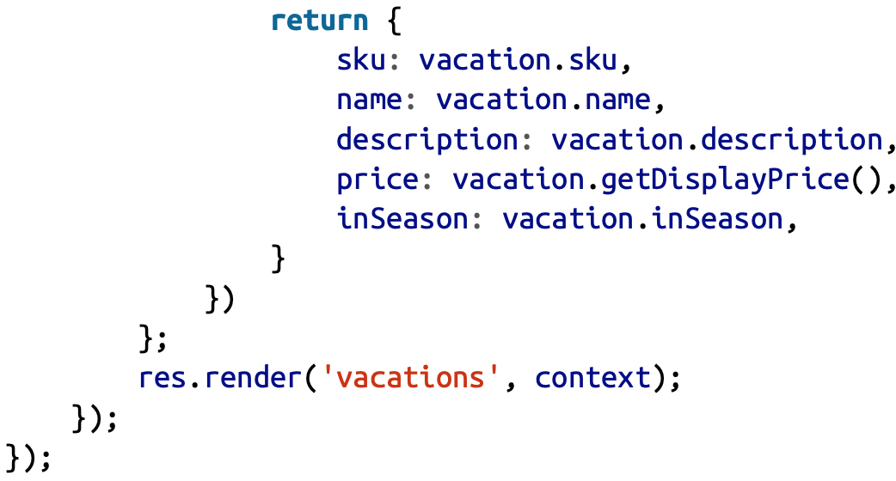
Retrieving Data
Now we can create route handlers that hook it all up:

Slide 24
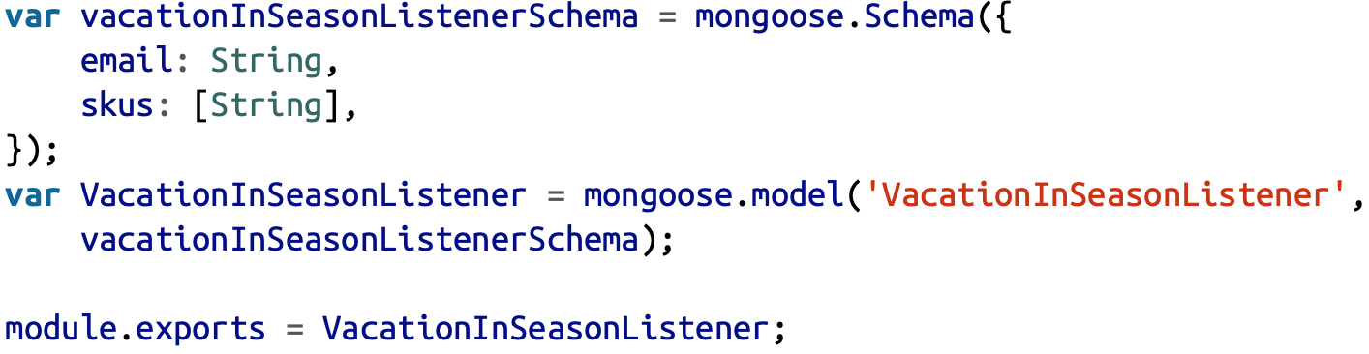
Adding Data
Create model object and call save method
To update data, let check other example: we create the schema and model (models/vacationInSeasonListener.js):
➔ new VacationInSeasonListener({email:”vdhong@...”, skus:”…”}).save();

Slide 25
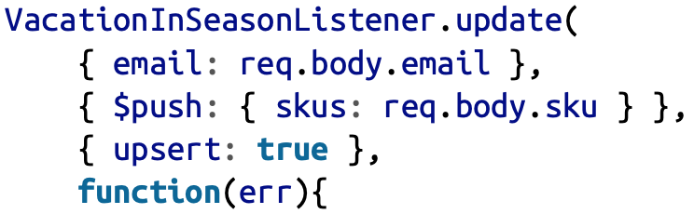
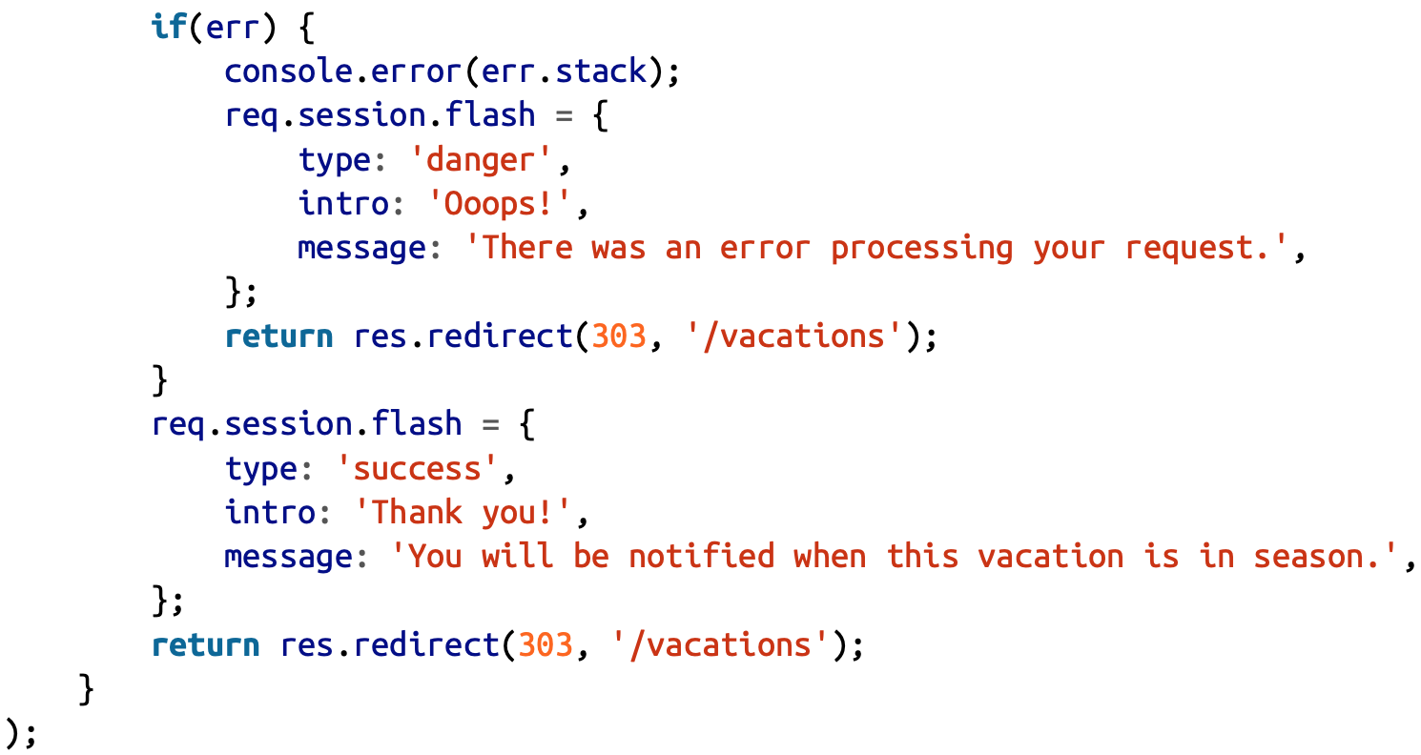
Updating Data
In route handler we can call update() like:

Slide 26
Exercise
Define student models and add some student data

